Slide 1
Gesture-driven presentations
Rodrigo Brechard Alarcia, Razvan Brinzea, Antonio Marsella,
Niklas Radtke, Tomasz Stanczyk
Notes:
Present:
Rodrigo
Razvan
Tomasz

Slide 2
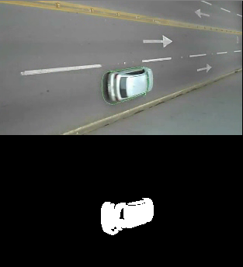
Background subtraction
Improve accuracy
Improve speed
Help for other algorithms, not enough alone
43 different algorithms

Slide 3


Classical Computer Vision
First, Background subtraction
Thresholding to extract hand section
Contour extraction
Deviations from it are considered as convexity defects
Deviations in the shape or position used as controlling signals

Slide 4
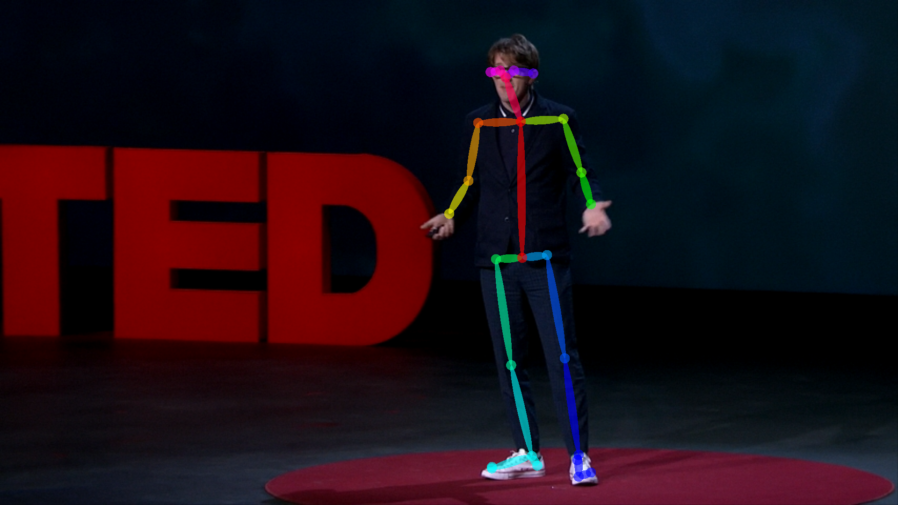
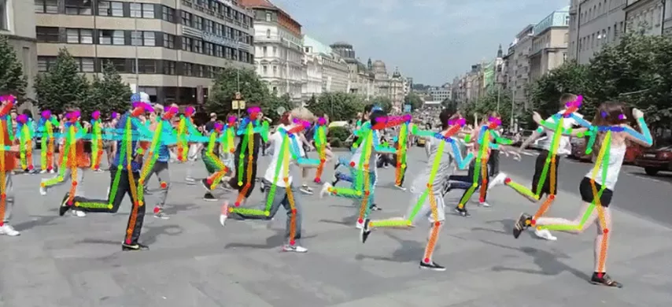
Pose detection
OpenPose library
Detect human body, hand, facial, and foot keypoints
Multi-stage CNN
Impressive results
Too slow in laptop

Slide 5
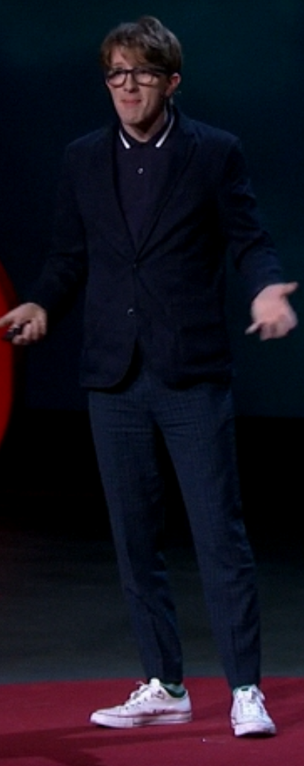
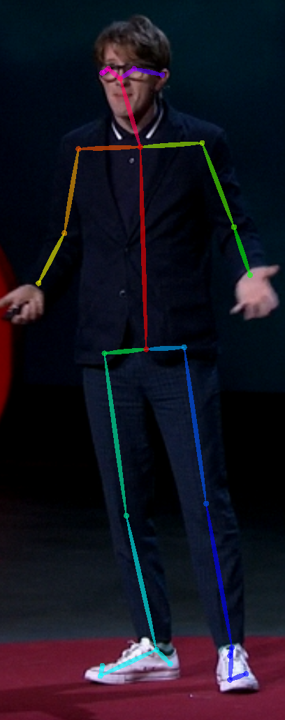
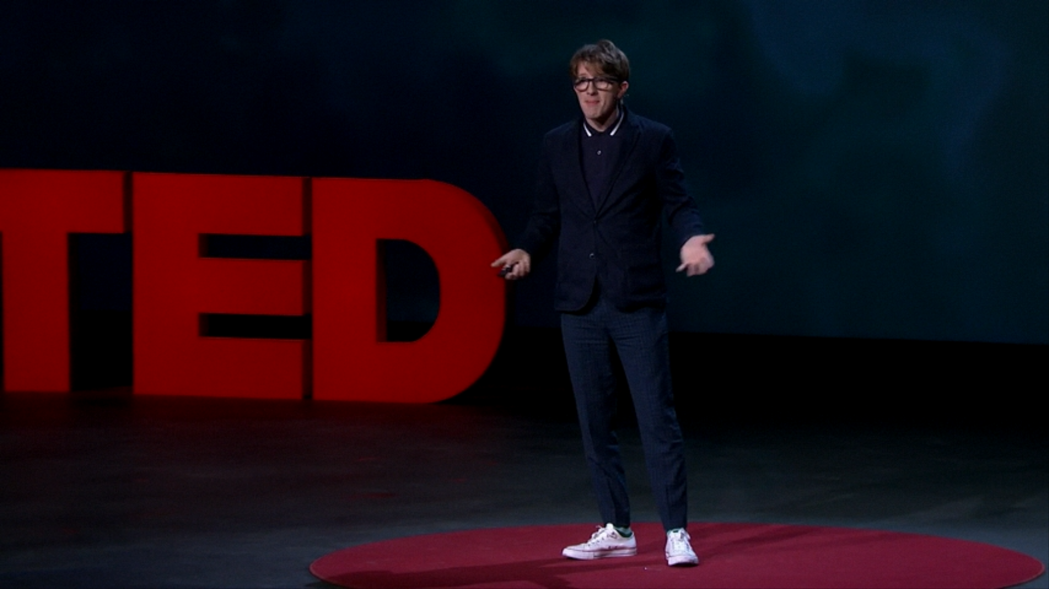
Object detection
YOLO (You only look once)
Extract area of interest to us in OpenPose

Slide 6
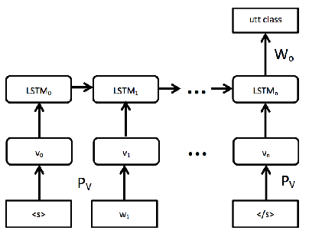
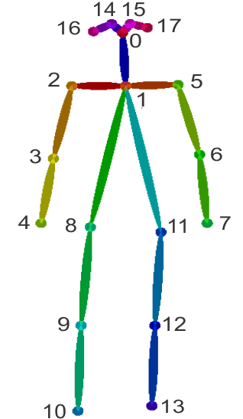
SVM/RNN
SVM for classifiers
LSTM use internal memory might be better option

